Slide 1
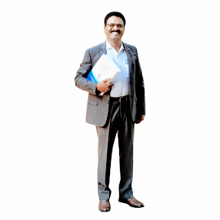

Dr K.S.KANNAN
M.A.,M.A.,M.A.,M.Ed.,PGDCA,Ph.D.,
School Assistant in Social Science, ZPHS (B), V. Kota,
Department of School Education, Chittoor District, AP.,

Slide 2
About Author
Dr K. S. KannanM.A,M.A,M.A, M.Ed, PGDCA, Ph.D, is an academician and researcher in the field of Social Sciences, currently serving as a School Assistant. He was awarded the degree of Doctor of Philosophy (Ph.D.) for his thesis entitled “The Role of Sarva Shiksha Abhiyan in Improving Quality Education: A Case Study in Chittoor District of Andhra Pradesh.” His scholarly contributions also include the authorship of another book titled “The Mental Health Status of Intermediate Students in Chittoor District of Andhra Pradesh: An Exploratory Study.”
With a strong passion for research and knowledge dissemination, Dr.K.S. Kannan has authored 2 books and published 10 research articles in reputed journals. His academic engagement spans across presenting papers at 3 international conferences, 2 international seminars, and 4 national seminars. He has further enriched academic discourse by actively participating in 4 international webinars and a national webinar (one-week programme).
In addition, Dr.K.S. Kannan has successfully completed two one-week online certificate programmes and has contributed to student learning through the organization of a national-level quiz competition.
His academic journey is distinguished by a commitment to critical inquiry, innovative teaching practices, and the advancement of Secondary and higher education. Dr.K.S. Kannan continues to inspire students and colleagues alike with his dedication to Social Sciences, striving to build meaningful bridges between research and classroom learning while contributing to academic excellence at both the national and international levels.

Slide 3
INDIA AND WORLD MAP PRACTICE BOOK
(8 Mark Map Points for 10th Class)
How to Answer 4+4= 8 Mark Map Questions
Always use a Pencil /Pen for marking and labeling
Write labels in clear, neat handwriting
Place labels outside the map with neat lines
Check spelling carefully marks is cut for wrong spelling
Revise the 10 most important places every day
Practice previous years’ map questions on blank maps
Mark at least 5 practice maps before the exam.
Quick Revision (10 Important Places)
Previous Years’ Map Questions
Practice Worksheets
Tips to Score Full Marks
Student Practice Pages
Map questions are sure-shot scoring
Dr K .S. KANNAN

Slide 4
CONTENTS
GEOGRAPHY
CHAPTERS | Map | Total Questions
Resources and Development | 1 | 1
Manufacturing Industries | 1 | 1
Lifelines of National Economy | 2(IC) | 2
HISTORY
The Making of Global World | 2(IC) | 2
Print Culture and Modern World | 2 | 2
DEMOCRATIC POLITICS
Political Parties | 2+1 (IC) | 3
Outcomes of Democracy | 1 (IC) | 1
ECONOMICS
Money and Credit | 2+2(IC) | 4
Dr K..S. KANNAN

Slide 5
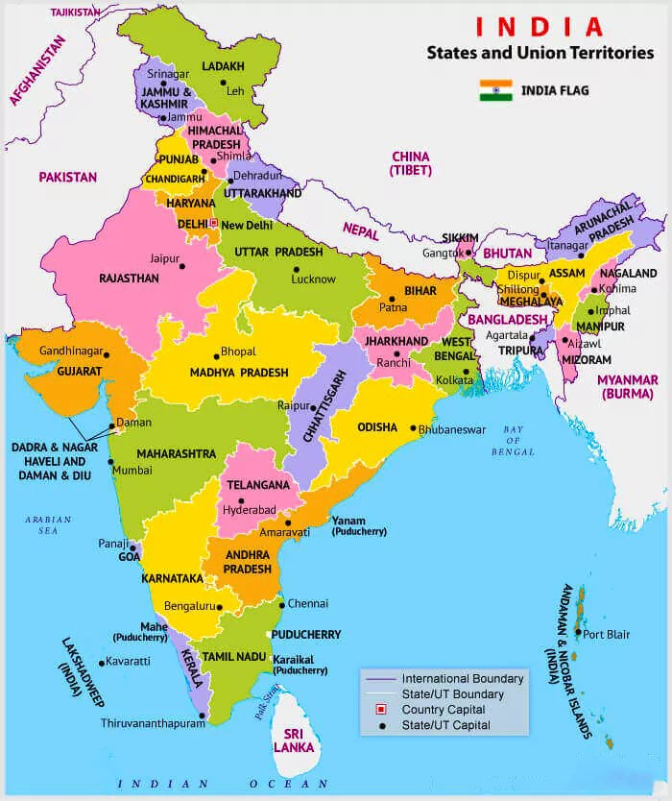
States and Capital Cities
Dr K. S. KANNAN,Ph.D
Notes:
States and Capital Cities

Slide 6
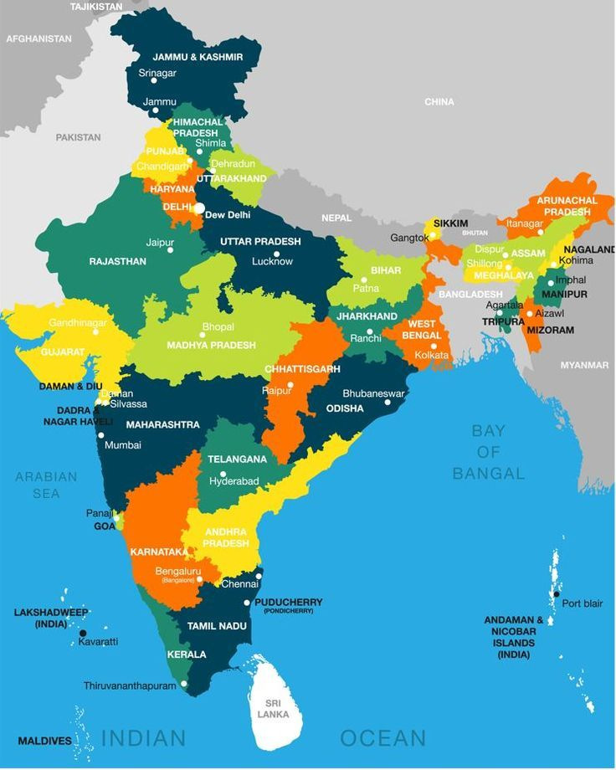
Dr K. S. KANNAN
Notes:
Dr K S KANNAN

Slide 7
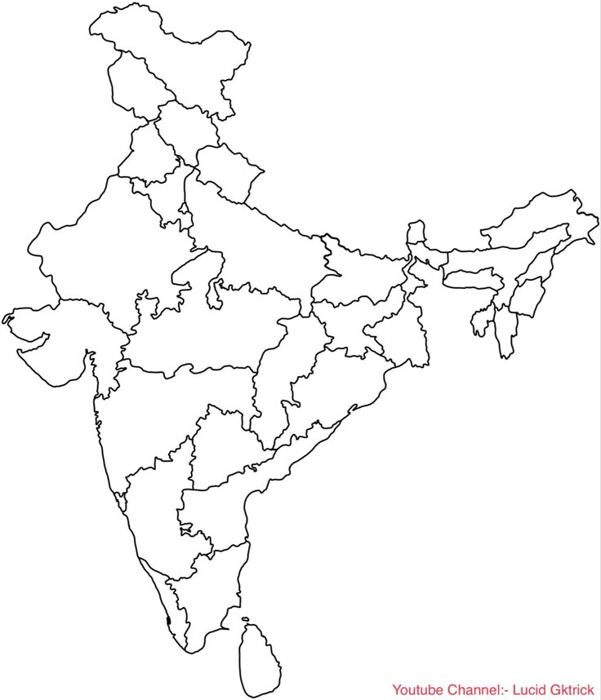
Locate the States and Capital Cities on India Map
Dr K.S.KANNAN,Ph.D
Notes:
States and Capital Cities
Locate the States and Capital Cities on Map

Slide 8
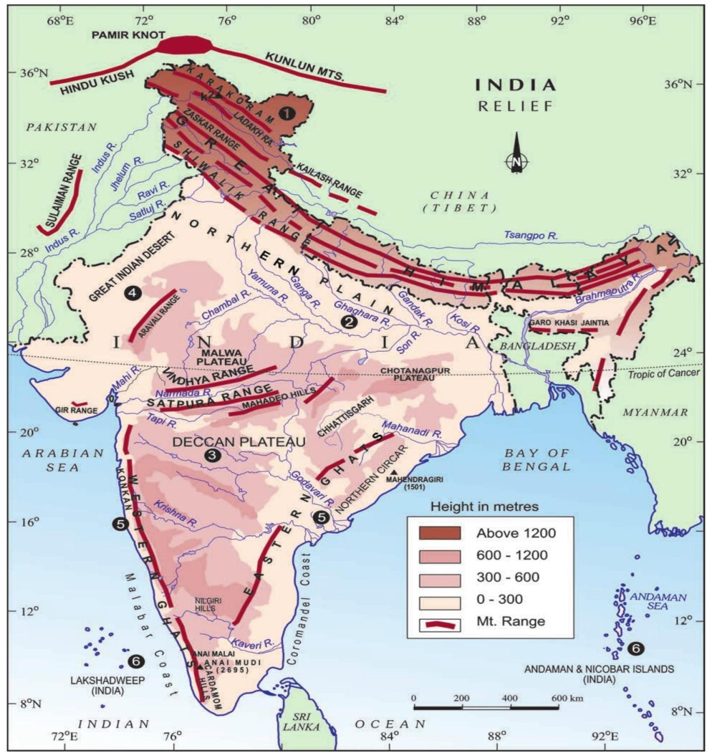
India Physical Map
Practice marking important physical features:
Himalayas, Indo-Gangetic Plains, Deccan Plateau, Thar Desert, CoastalPlains, Islands.
Rivers: Ganga, Yamuna, Godavari, Krishna, Narmada, Tapi, Brahmaputra.
Mountains: Aravalli, Vindhya, Satpura, Western Ghats, Eastern Ghats.
Dr K.S.KANNAN,Ph.D
Notes:
Dr K.S.KANNAN,Ph.D

Slide 9
Resource and Development
Soil types:
Practice locating soil types on the map:
Alluvial: Northern Plains (Punjab,Haryana, Uttar Pradesh, Bihar, West Bengal)
Black: Maharashtra, Madhya Pradesh, Gujarat, Karnataka
Red: Tamil Nadu, Karnataka, Andhra Pradesh
Laterite:Kerala, Odisha, West Bengal, North Eastern States
Desert: Rajasthan

Slide 10
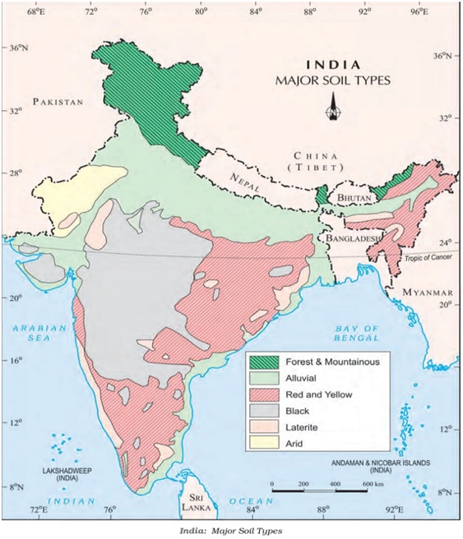
Dr K.S.KANNAN,Ph.D
Notes:
Dr K.S.KANNAN,Ph.D

Slide 11
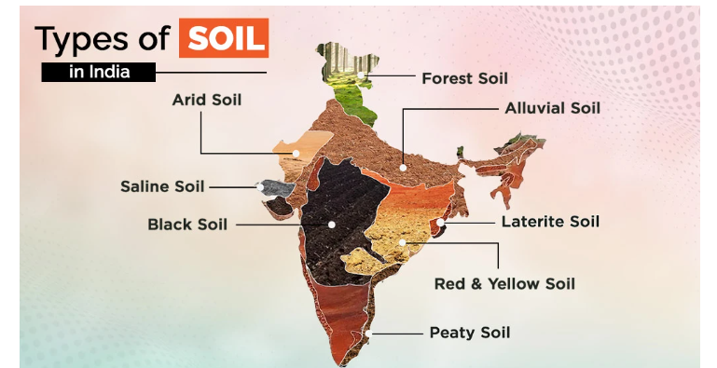
Dr K.S.KANNAN
Notes:
Dr K.S.KANNAN

Slide 12
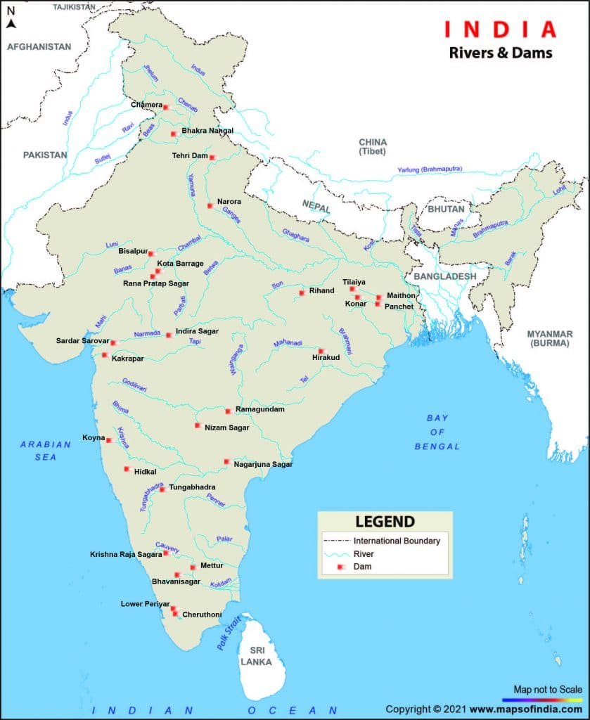
Dr K.S.KANNAN

Slide 13
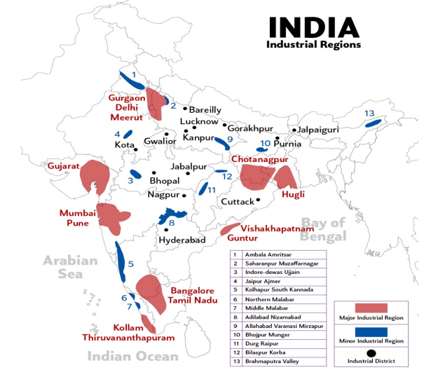
Industrial Regions
Dr K.S.KANNAN

Slide 14
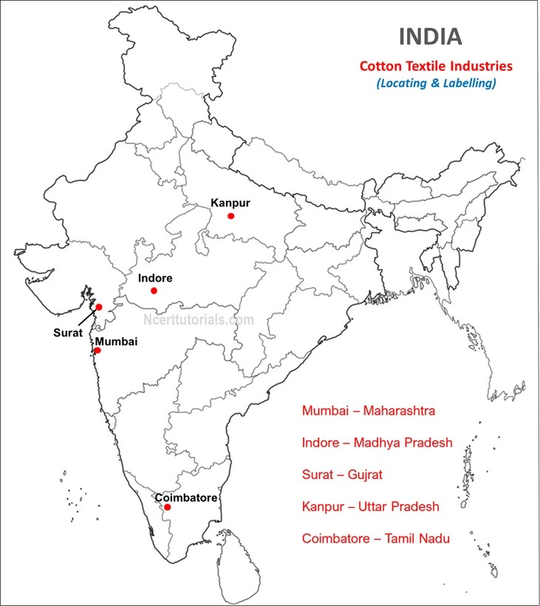
Cotton Textile Industries
Mumbai, Indore, Surat, Kanpur, Coimbatore
Dr K.S.KANNAN

Slide 15
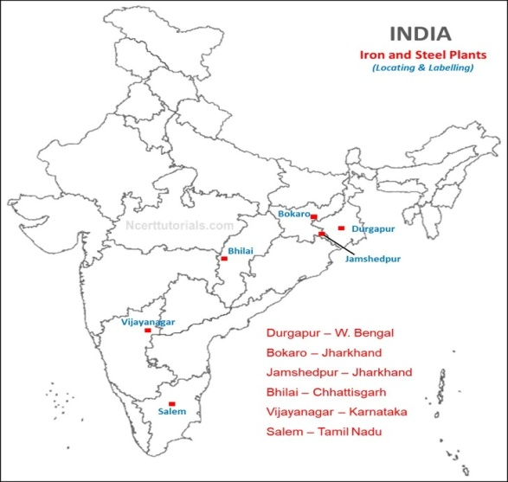
Iron and Steel Plants
Durgapur, Bokaro, Jamshedpur, Bhilai, Vijayanagar and Salem
Dr K.S.KANNAN

Slide 16
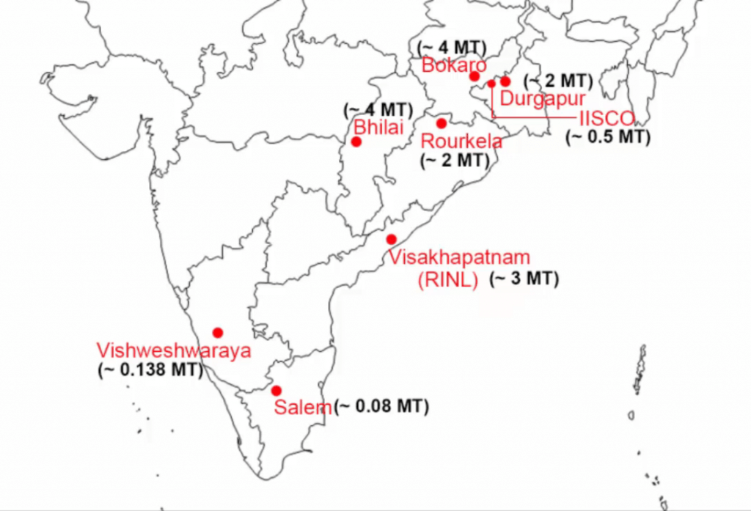
Dr K.S.KANNAN

Slide 17
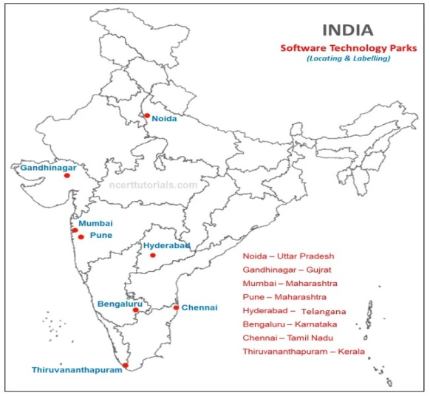
Software Technology Parks
Noida, Gandhinagar, Hyderabad, Bengaluru, Chennai, and Pune
Thiruvananthapuram
Dr K.S.KANNAN

Slide 18
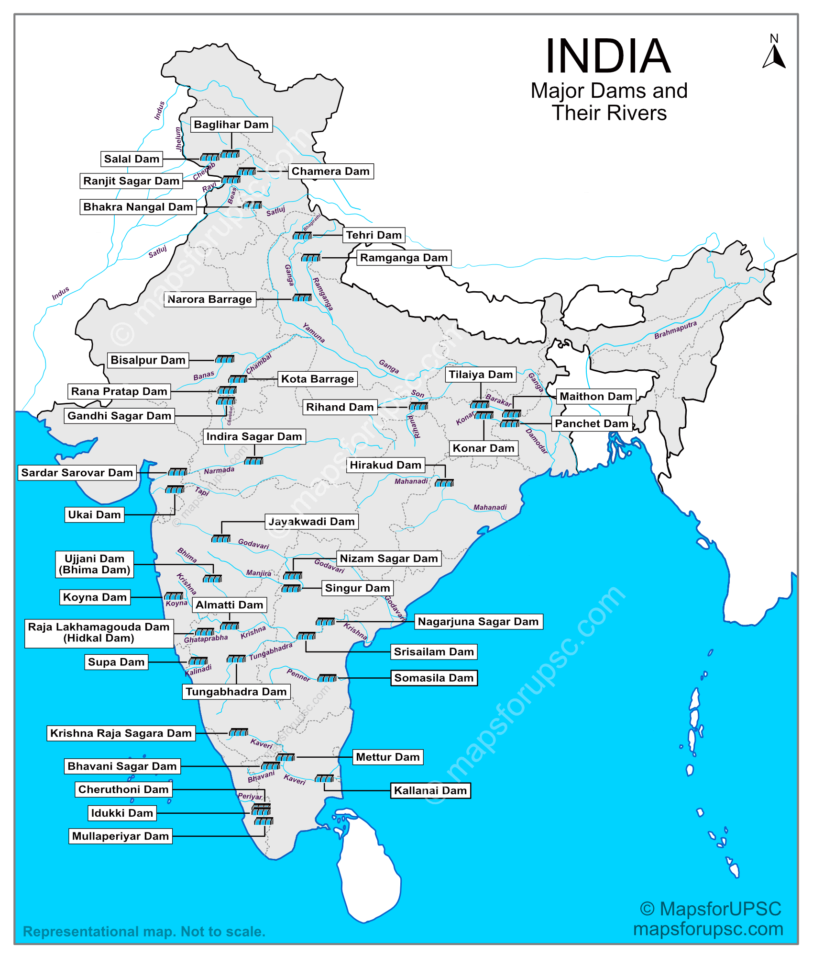
Major Dams and Rivers in India
Dr K.S.KANNAN

Slide 19
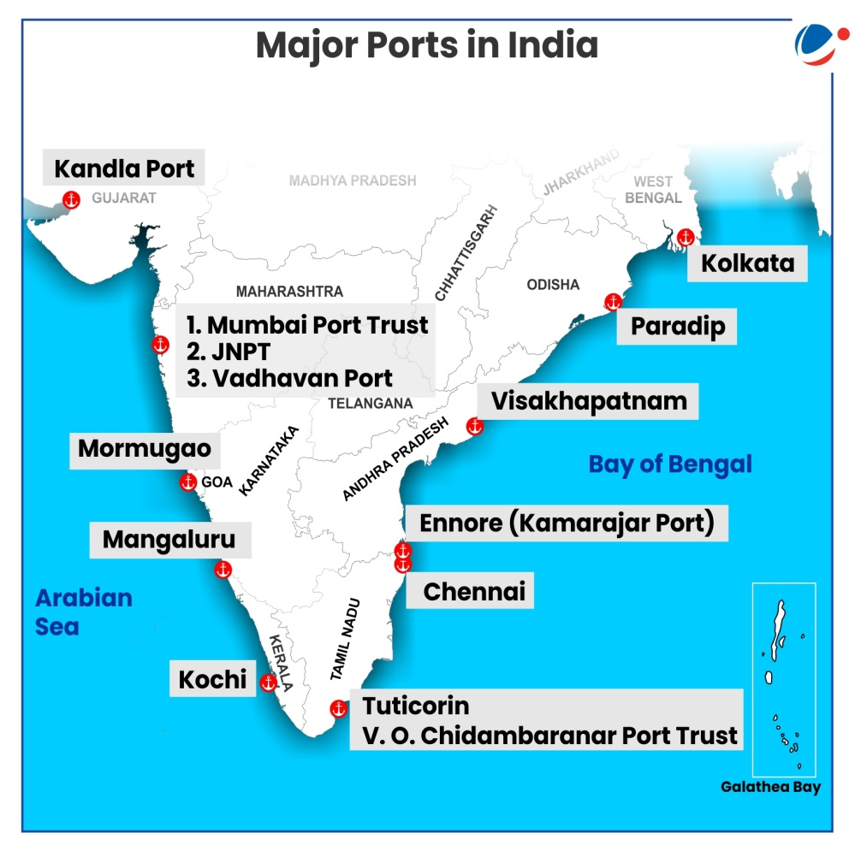
. Lifelines of National Economy
Major Sea Ports
Kandla Tuticorin Chennai Vishakhapatnam Marmagao
Paradip Haldia Kochi New Mangalore
Dr K.S.KANNAN

Slide 20
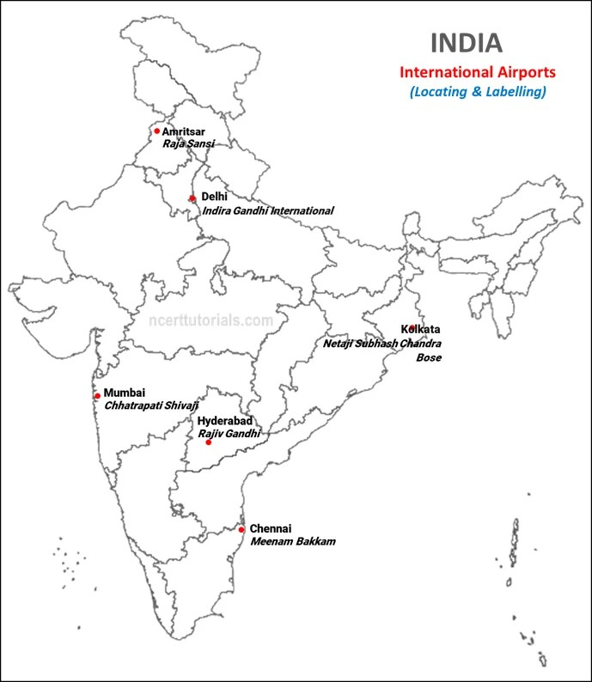
International Airports
Amritsar (Raja Sansi)
Delhi (Indira Gandhi International)
Mumbai (Chhatrapati Shivaji)
Chennai (Meenam Bakkam)
Kolkata (Netaji Subhash Chandra Bose)
Hyderabad (Rajiv Gandhi)
Dr K.S.KANNAN

Slide 21
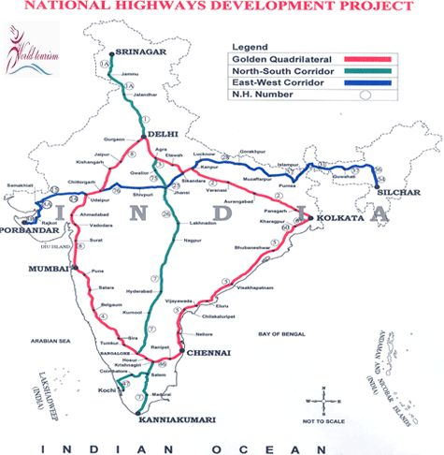
National Highways
Golden Quadrilateral (Delhi-Mumbai-Chennai-Kolkata)
North-South Corridor (Srinagar to Kanyakumari)
East-West Corridor (Silchar to Porbandar)
National Highway 1 (Delhi to Attari)
National Highway 2 (Delhi to Kolkata)
National Highway 7 (Varanasi to Kanyakumari)
Dr K.S.KANNAN

Slide 22
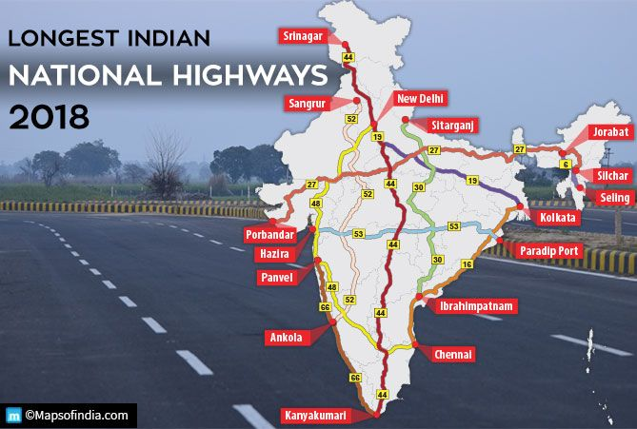
Dr K.S.KANNAN

Slide 23
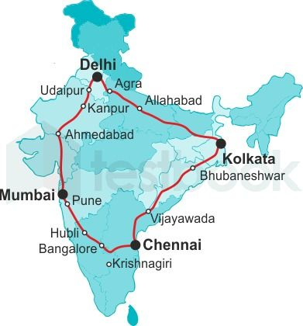
Golden quadrilateral Super Highway
Dr K.S.KANNAN

Slide 24
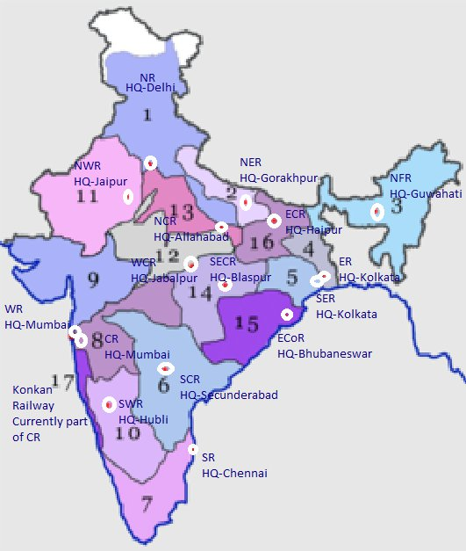
Railway Zones
Dr K.S.KANNAN

Slide 25
Minerals and Industries
  Coal- Jharkhand, Chhattisgarh, Odisha
  Iron- Odisha, Chhattisgarh, Karnataka
  Bauxite (Odisha, Gujarat)
  Bhilai (Steel Plant)
  Rourkela (Steel Plant)
  Durgapur (Steel Plant)
  Bokaro (Steel Plant)
  Raniganj (Coalfield)
  Jharia (Coalfield)
  Mumbai Port
  Chennai Port
  Ganga River
  Himalayas
Dr K.S.KANNAN

Slide 26
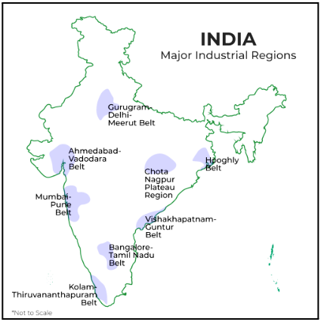
Dr K.S.KANNAN

Slide 27
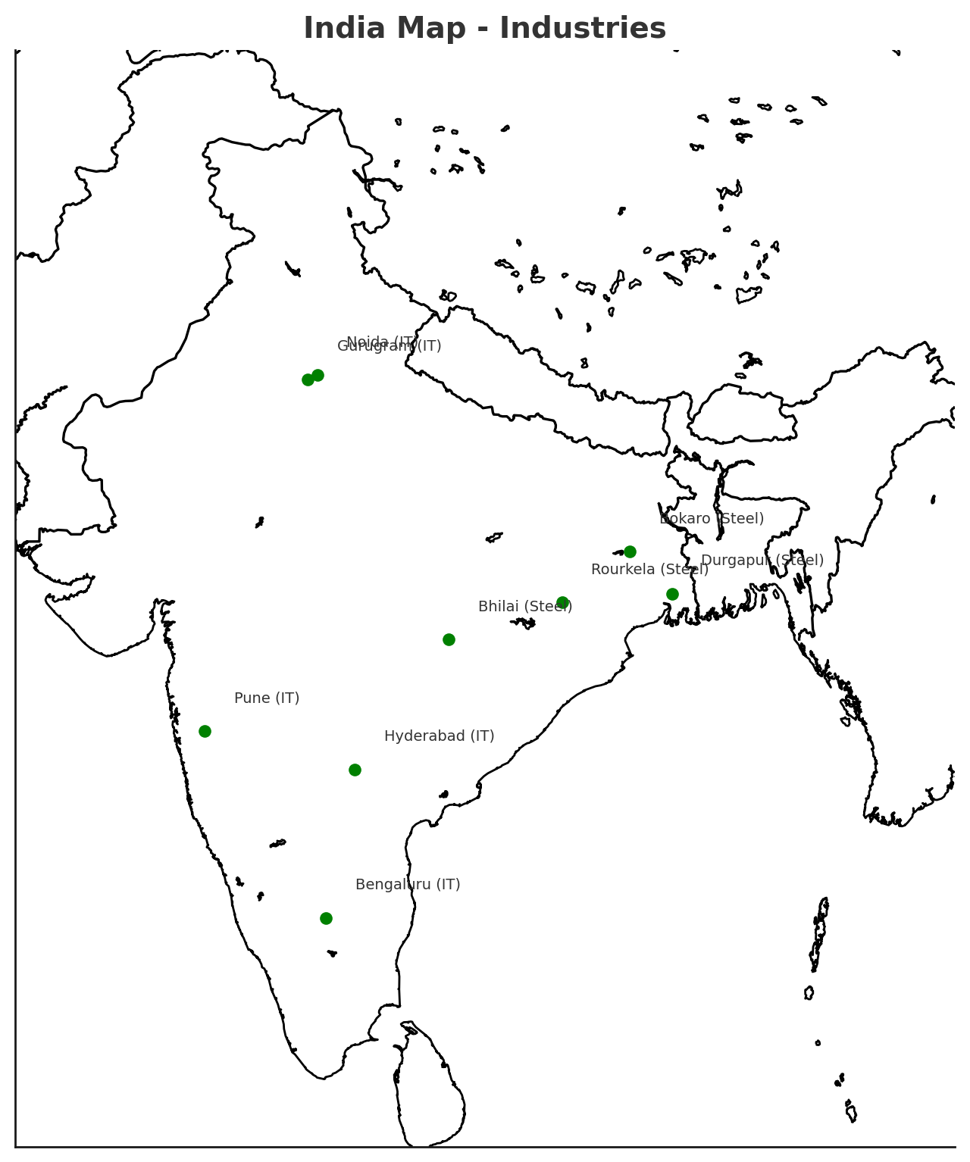
Dr K.S.KANNAN

Slide 28
The Making of Global World
Important Trade Routes
Silk Route (Asia-Europe)
Spice Trade (India-South East Asia-Europe)
Slave Trade Route (Africa-Americas-Europe)
Triangular Trade (Europe-Africa-America)
Industrial Centers in Europe (Manchester, London)
Colonial Connections
British Colonies: India, Australia, Africa
Portuguese: Goa, Brazil, parts of Africa
Dutch: Indonesia
French: Indo-China, Pondicherry, parts of Africa
Key Commodities of Global Trade
Opium (India-China)
Tea (China, India)
Sugar (Caribbean)
Cotton & Textiles (India, Britain)
Gold/Silver (Latin America–Europe-Asia)
Dr K.S.KANNAN

Slide 29
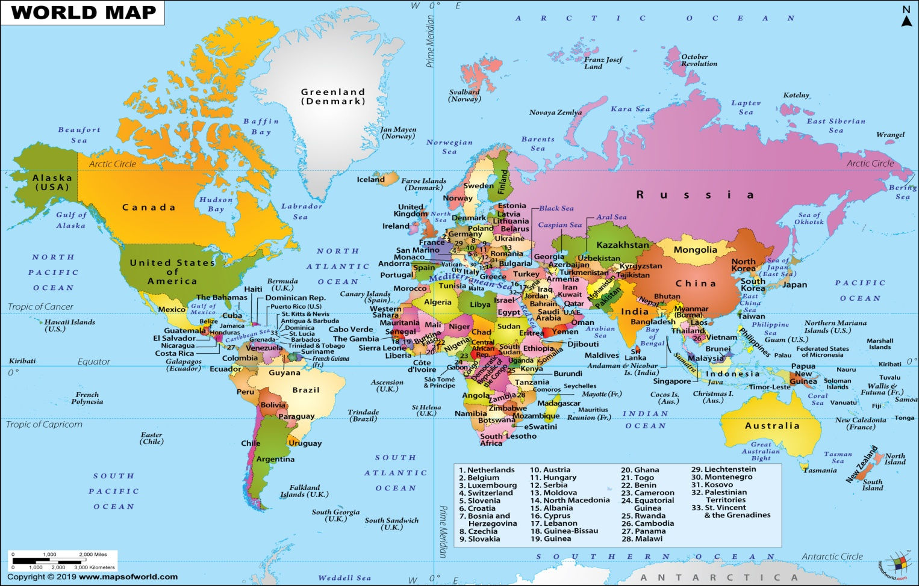
Dr K.S.KANNAN

Slide 30
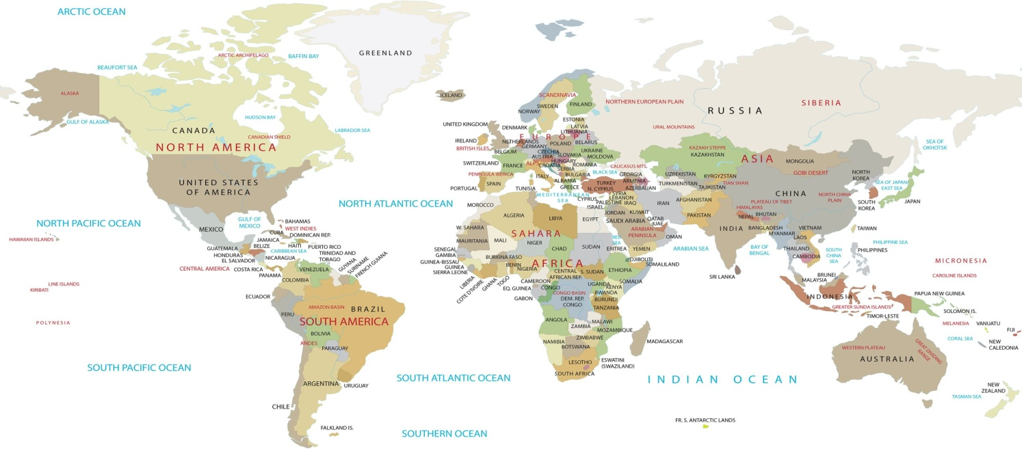
Dr K.S.KANNAN

Slide 31
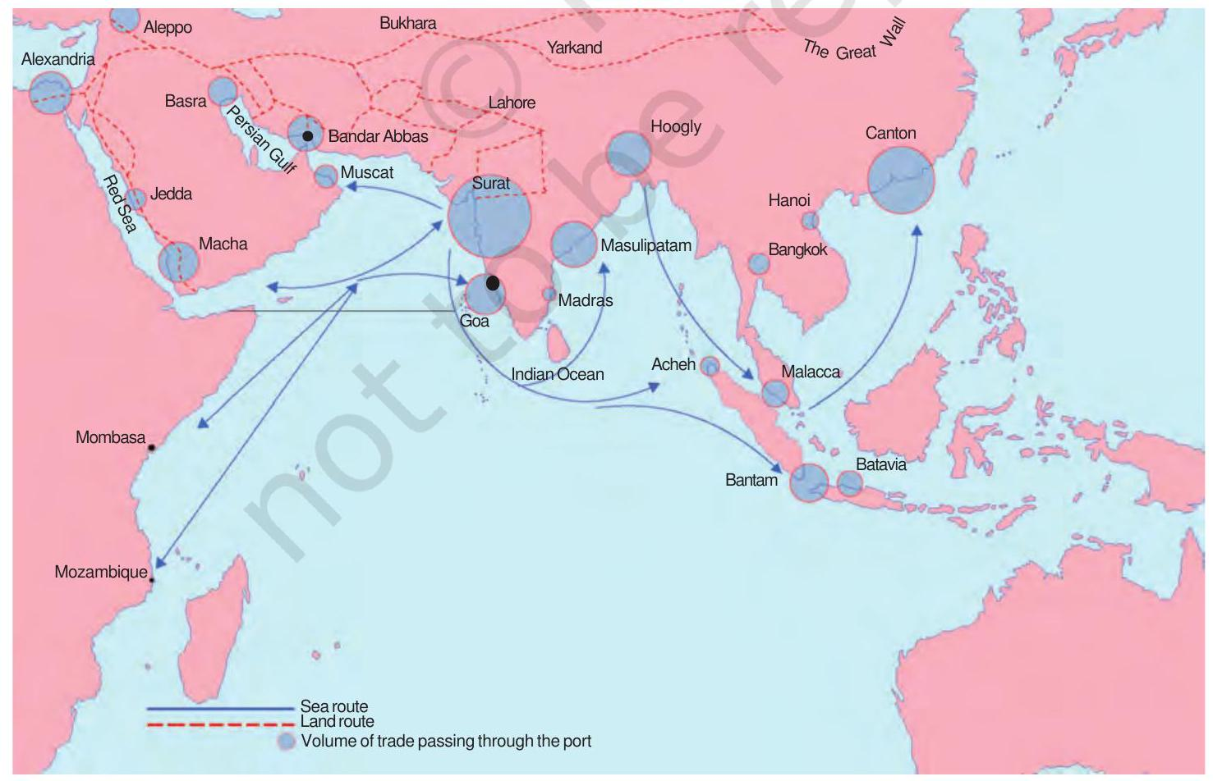
Trade Routes
Dr K.S.KANNAN

Slide 32
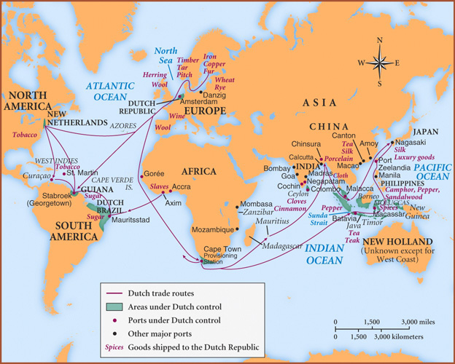
Dr K.S.KANNAN

Slide 33
Print Culture and Modern World
Origin and Spread of Print Culture
China - Woodblock printing (Tang and Song Dynasties)
Japan - Buddhist texts printing
Korea - Movable metal type (early)
Germany (Mainz) -Gutenberg’s Press (15th Century)
Britain, France, Italy -Spread of books and pamphlets
America - Colonial newspapers and pamphlets (18th Century)
Printing in Colonial India
Goa - First books by Portuguese missionaries
Calcutta (Kolkata) -Early printing centers
Bombay (Mumbai) -Growth of newspapers
Dr K.S.KANNAN

Slide 34
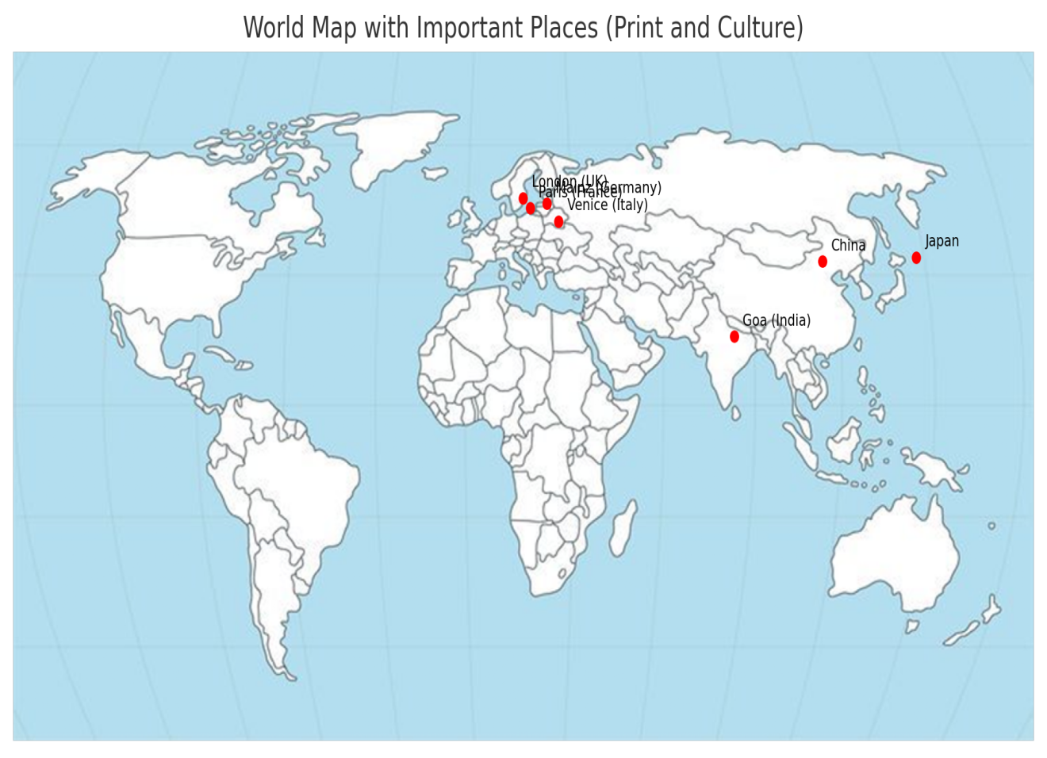
Dr K.S.KANNAN

Slide 35
Political Parties
National Political Parties
Indian National Congress (INC) -HQ: New Delhi, strong in Rajasthan, Chhattisgarh, Karnataka, Himachal Pradesh
Bharatiya Janata Party (BJP)- HQ: New Delhi, strong in Uttar Pradesh, Gujarat, Madhya Pradesh, Assam, many states
Communist Party of India (CPI) -strong in Kerala, West Bengal, Tripura
Communist Party of India (Marxist) CPI(M) - strong in Kerala, West Bengal, Tripura
Bahujan Samaj Party (BSP) - HQ: New Delhi, strong in Uttar Pradesh
Nationalist Congress Party (NCP) - HQ: New Delhi, strong in Maharashtra
All India Trinamool Congress (AITC) - strong in West Bengal
National People’s Party (NPP) - Meghalaya, Manipur, Nagaland, Arunachal Pradesh
Dr K.S.KANNAN

Slide 36
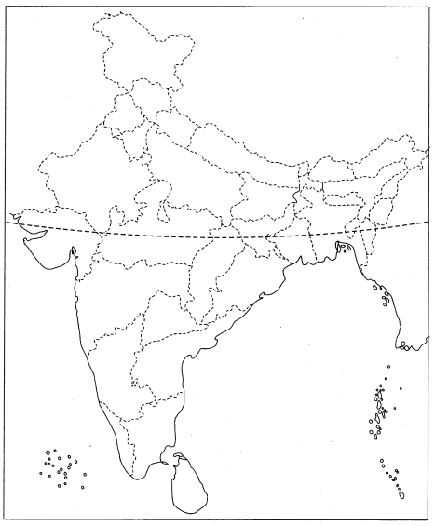
K.S.KANNAN

Slide 37
Regional Parties
DMK, AIADMK - Tamil Nadu
Telangana Rashtra Samithi (BRS) - Telangana
Shiv Sena (UBT/Shinde) - Maharashtra
Janata Dal (United) JD(U) -Bihar
Rashtriya Janata Dal (RJD) -Bihar
Biju Janata Dal (BJD) - Odisha
Telugu Desam Party(TDP)- Andhraz Pradesh
YSR Congress Party -Andhra Pradesh
Samajwadi Party (SP) - Uttar Pradesh

Slide 38
Dr K.S.KANNAN

Slide 39
Outcomes of Democracy
Green Democratic Countries
Red Non-democratic Countries
Blue Transition to Democracy
Old Democracies : India, USA, UK
New Democracies: South Africa (1994), Nepal (2008)
Non-Democracies: Saudi Arabia, China, Myanmar
Countries with Military Rule in the Past:
Pakistan, Chile
Dr K.S.KANNAN

Slide 40
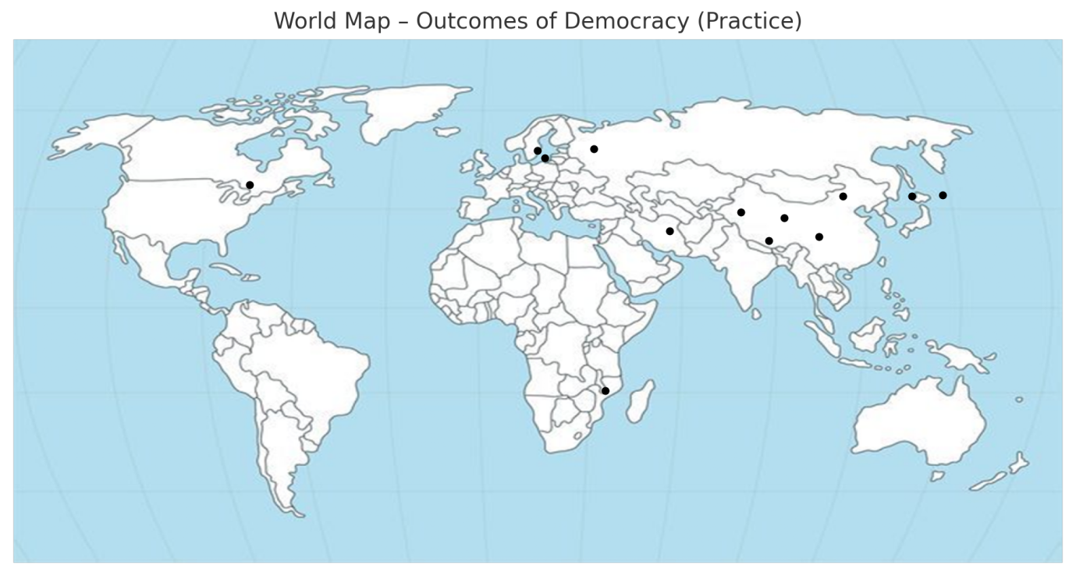
Dr K.S.KANNAN

Slide 41
Money and Credit
Reserve Bank of India (RBI) -Mumbai
State Bank of India (SBI) -Mumbai
NABARD -Mumbai
Regional Rural Banks - Present in states like Uttar Pradesh, Bihar, Odisha, Andhra Pradesh
Cooperative Credit Societies -Maharashtra, Gujarat, Punjab, Karnataka
Microfinance Institutions -Bihar, Odisha, Andhra Pradesh, Southern States
Dr K.S.KANNAN

Slide 42
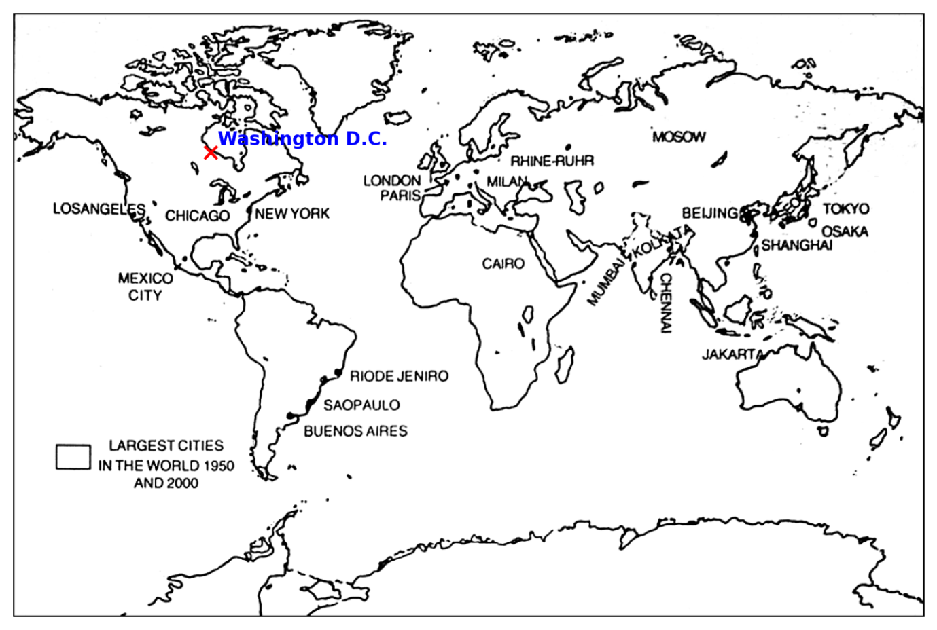
Dr K.S.KANNAN

Slide 43
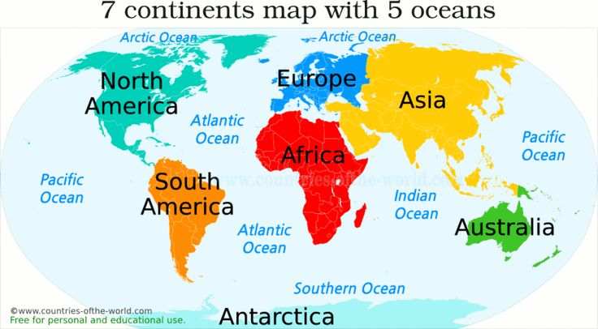
WORLD MAP FOR PARACTICE
Dr K.S.KANNAN

Slide 44
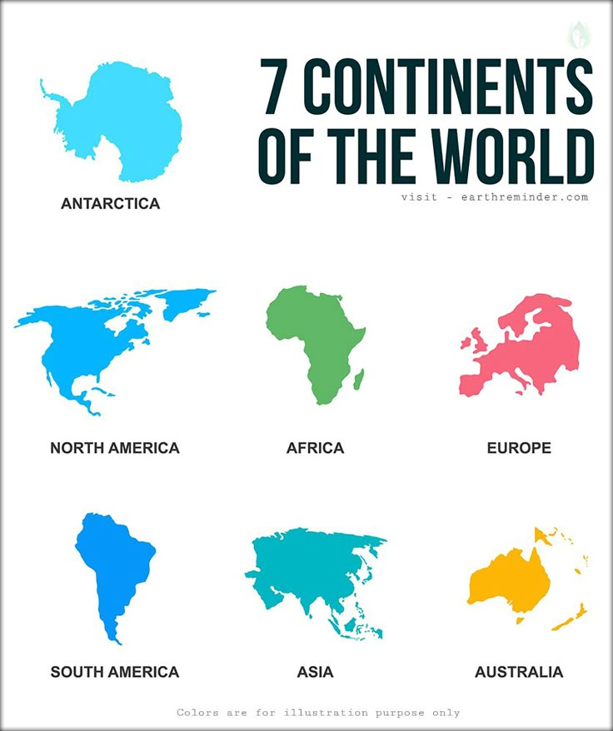
Dr K.S.KANNAN

Slide 45
Dr K.S.KANNAN

Slide 46
Dr K.S.KANNAN

Slide 47
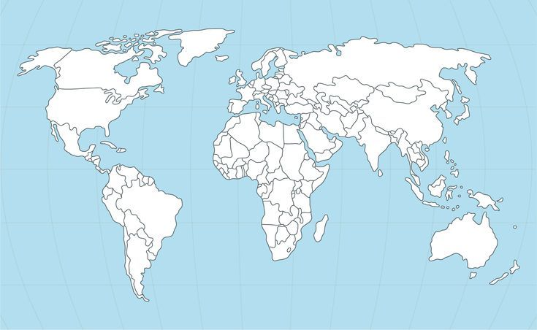
On the given World Map, locate the following countries:
Britain India Germany Bangladesh France Italy Japan China Korea USA Australia New Zealand Spain South Africa Egypt Madagascar Canada Brazil Belgium Sri Lanka Nigeria
Dr K.S.KANNAN

Slide 48
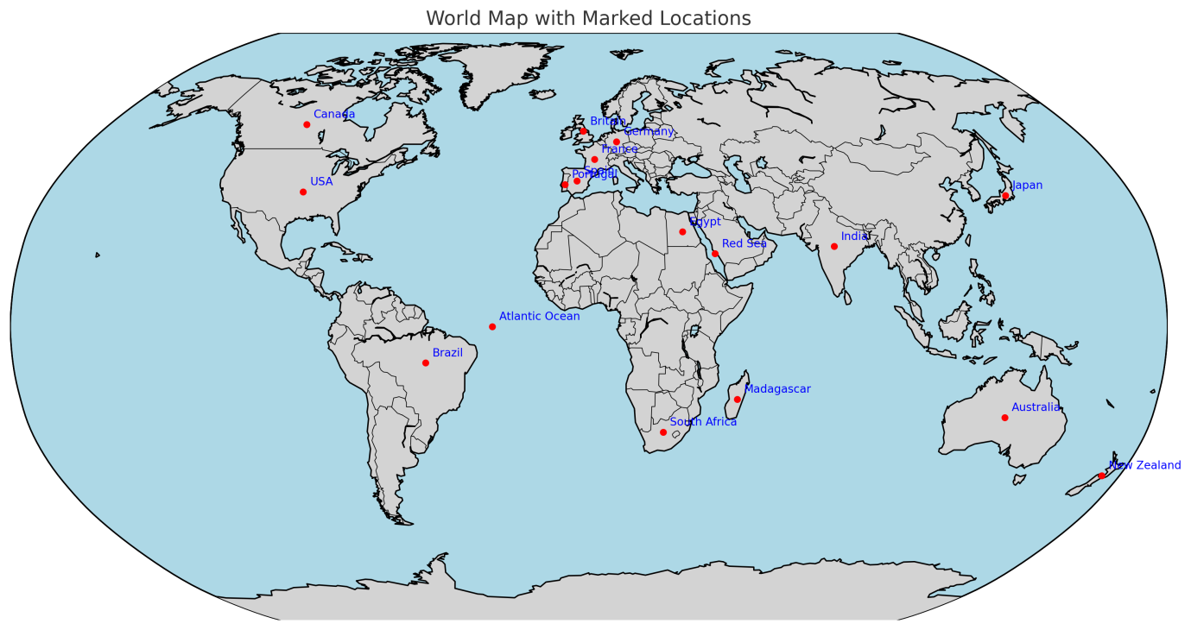
Dr K.S.KANNAN

Slide 49
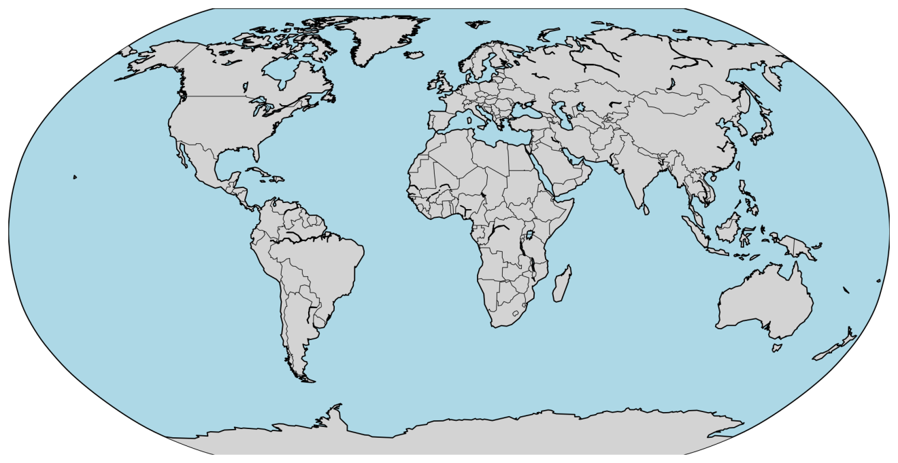
K.S.KANNAN
Dr K.S.KANNAN

Slide 50
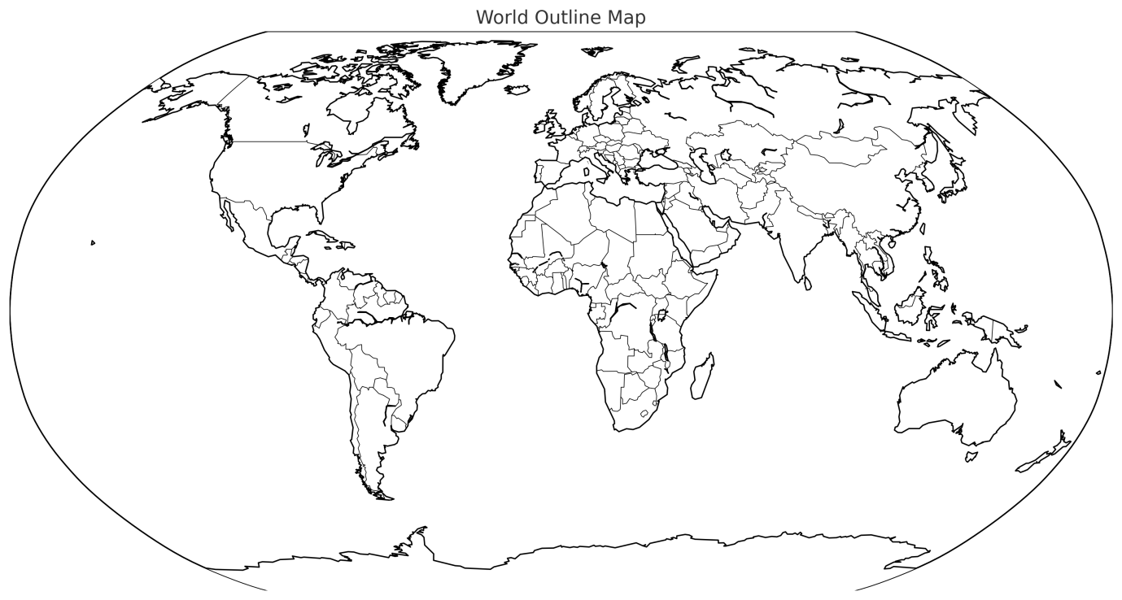
Dr K.S.KANNAN
K.S.KANNAN

Slide 51

NAMASTHE

